Slide 1


Scheduling Project Group 13
Team Members:
Anisha
Daniel
Nawaf
Stanley

Slide 2
Introduction
This project is being developed for tracking the class ID, class time, Professor availability and classrooms within SCE department. This system is secure and easy for both students and professors checking their availability time along with the classrooms.

Slide 3

Goals and Objectives
The system should be useful. It should provide information about different class time for students.
The device should be convenient and easy to use. It should require no overlapping time schedule within two different professors.
The system should offer at least provide option to students to choose two different times for one class. The system should include at two modes: day class time mode and night class.

Slide 4
Constraints
The project must be a web application since UMKC issued computers prevent users from installing programs. The final product must also not rely on third party licensed software.
Users do not come from a technical background and will have to be able to interface with software easily.

Slide 5
Scope
At the minimum, the software will allow users to create constraints with varying priorities for individual professors and allow the user to place professors and classes into a schedule and determine if any constraint is violated. The scope can be extended to generating the best-fit schedule with least amount of constraints violated.

Slide 6
Tools
Programming Language – Python
Version Control – source code and written artifacts will be stored in a Subversion repository.
Defect tracking – defects and issues will be tracked using Django and Trello.
Build tools – local and main builds will be done using GitHub.
Automated testing – unit tests will be implemented with the JUnit testing framework.

Slide 7
Customer and Users
SCE faculty members and staffs
Prospective UMKC SCE Students
Professors

Slide 8
Risks and Obstacles To Success
Due to COVID-19, it impacted our classes, projects, personal lives (family issues, job hardship), have to travel back to home countries which results in improper distribution of the workload and experimenting with an unknown form of development led to some of our project’s vision go unfulfilled.
The team does not have a lot of experience with git and Django python web interface. Lack of experience cause under and overestimates for complexity and time on features we plan to implement.

Slide 9
Success Criteria
The project will be a success if by the end of the semester, users can generate decent schedules that violate the least amount of constraints and can use them to plan the next semesters schedule effectively applicable from May 15, 2020.

Slide 10
Algorithms & techniques
Simulated Annealing
method for solving unconstrained and bound-constrained optimization problems.
Generating schedules at a high temperature to reach the most optimized version of the schedule within the pre-determined constraints.
Genetic Scheduling
reflects the process of natural selection where the fittest individuals are selected for reproduction in order to produce offspring of the next generation.
The fittest individuals, in this case, are the instructors that are fittest to the (x) course at (x) time.

Slide 11
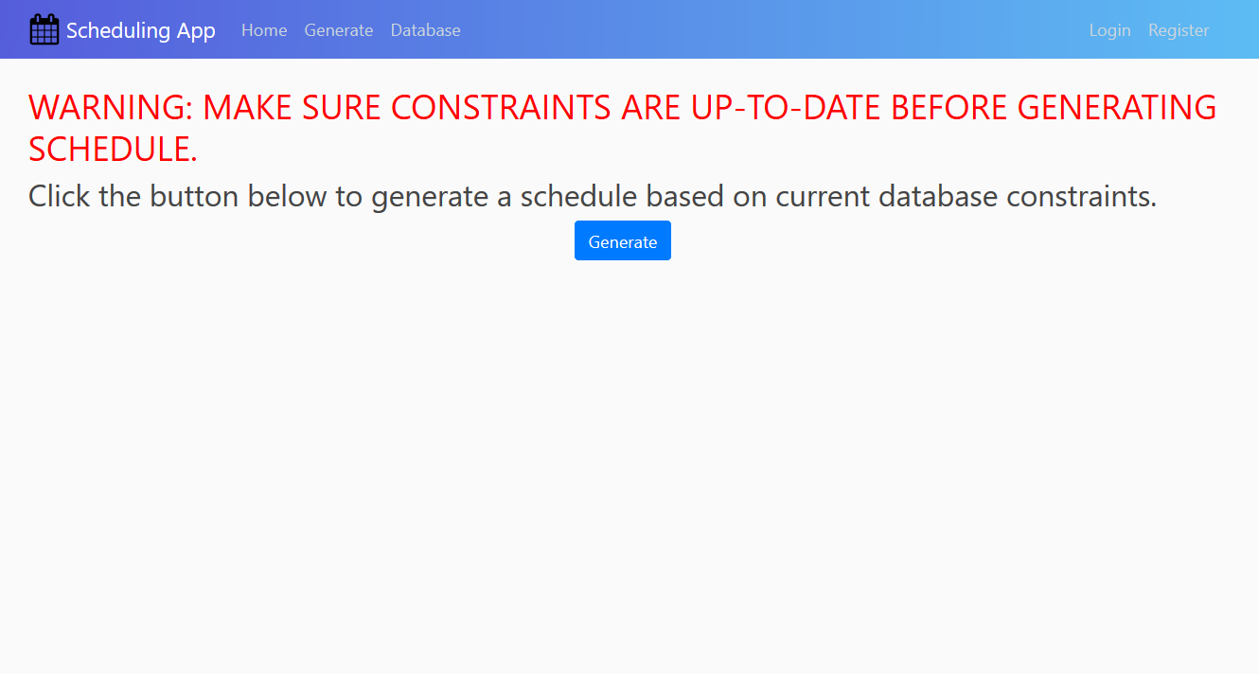

Slide 12
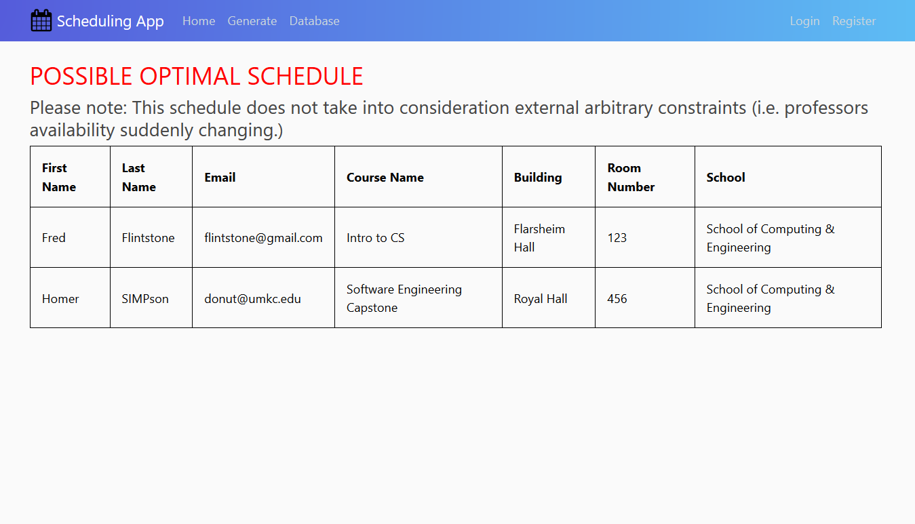

Slide 13
Terminology
System – Tracking the professor and student’s availability along with classrooms within UMKC SCE database
User – Professors and students will login to the scheduling system, type of user will be specified
Site- the front-end website (main page) using web mail
Username/Password- unique identifiers that authenticate and validates a user

Slide 14
Terminology
Login - the act of logging in to a computer, database, or system
Authentication - the process or action of verifying the identity of a user
Active Directory (AD) – System that will allow users to authenticate to UMKC network
Connection – Link between devices on a network

Slide 15
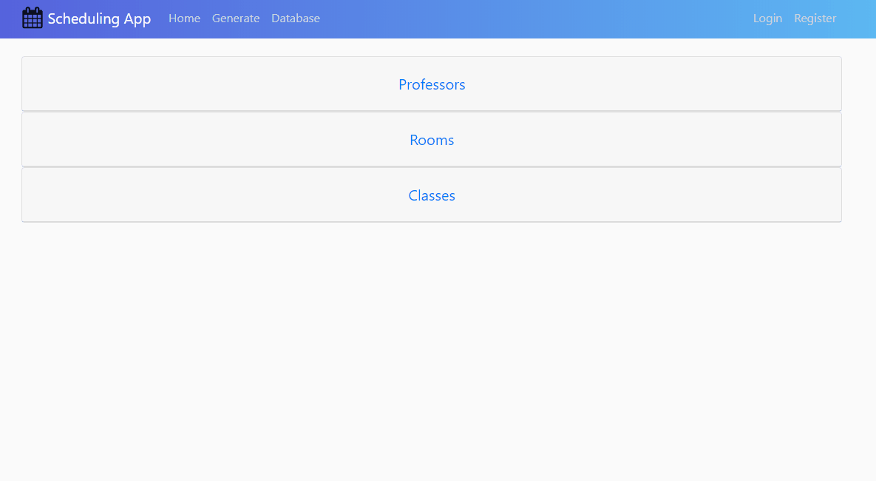
Design-Collapsible Tables

Slide 16
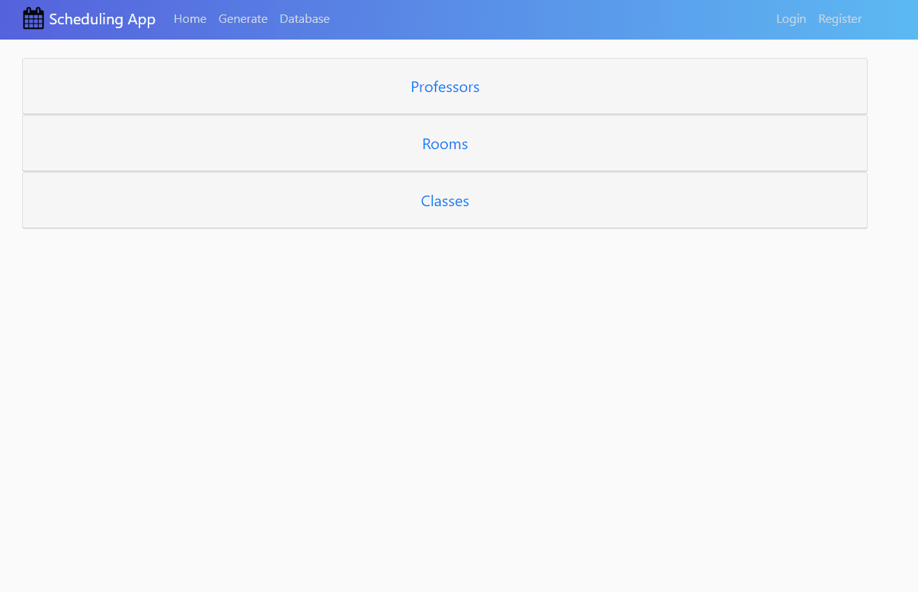
Design-CRUD Functions

